Slide 1

Application of Text Analytic Method in
Automatic Information Analysis from
Refinery News Corpus
DONG Fang LU Di TANG Yue
YIN Xiaolan YOU Pingping ZHANG Jiale
Group 2-1
Apr 17th 2021

Slide 2

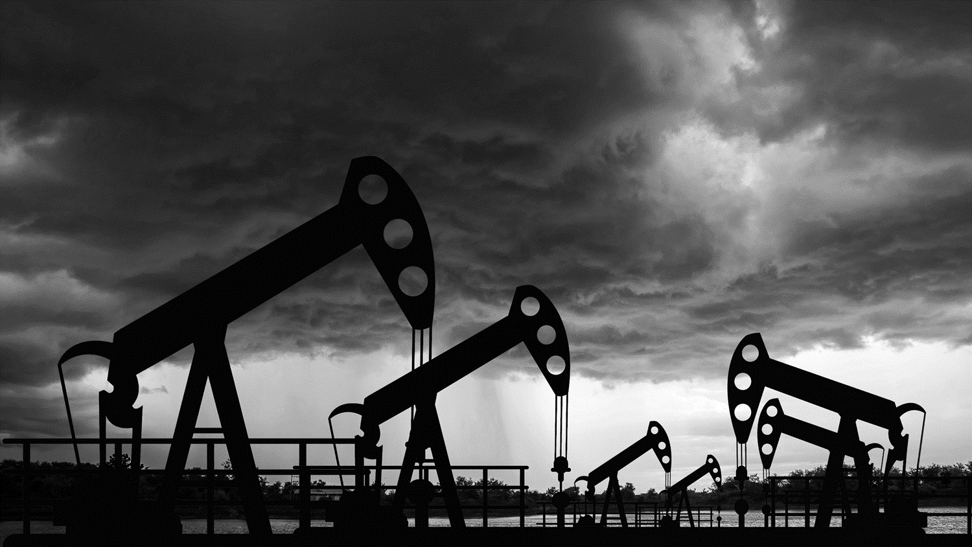
CONTENTS
01
Introduction
02
Methodology
03
Experiments
& Analysis
04
Conclusion
05
Reflection

Slide 3
01
INTRODUCTION
Background and Motivations
Project Objectives and Tasks

Slide 4
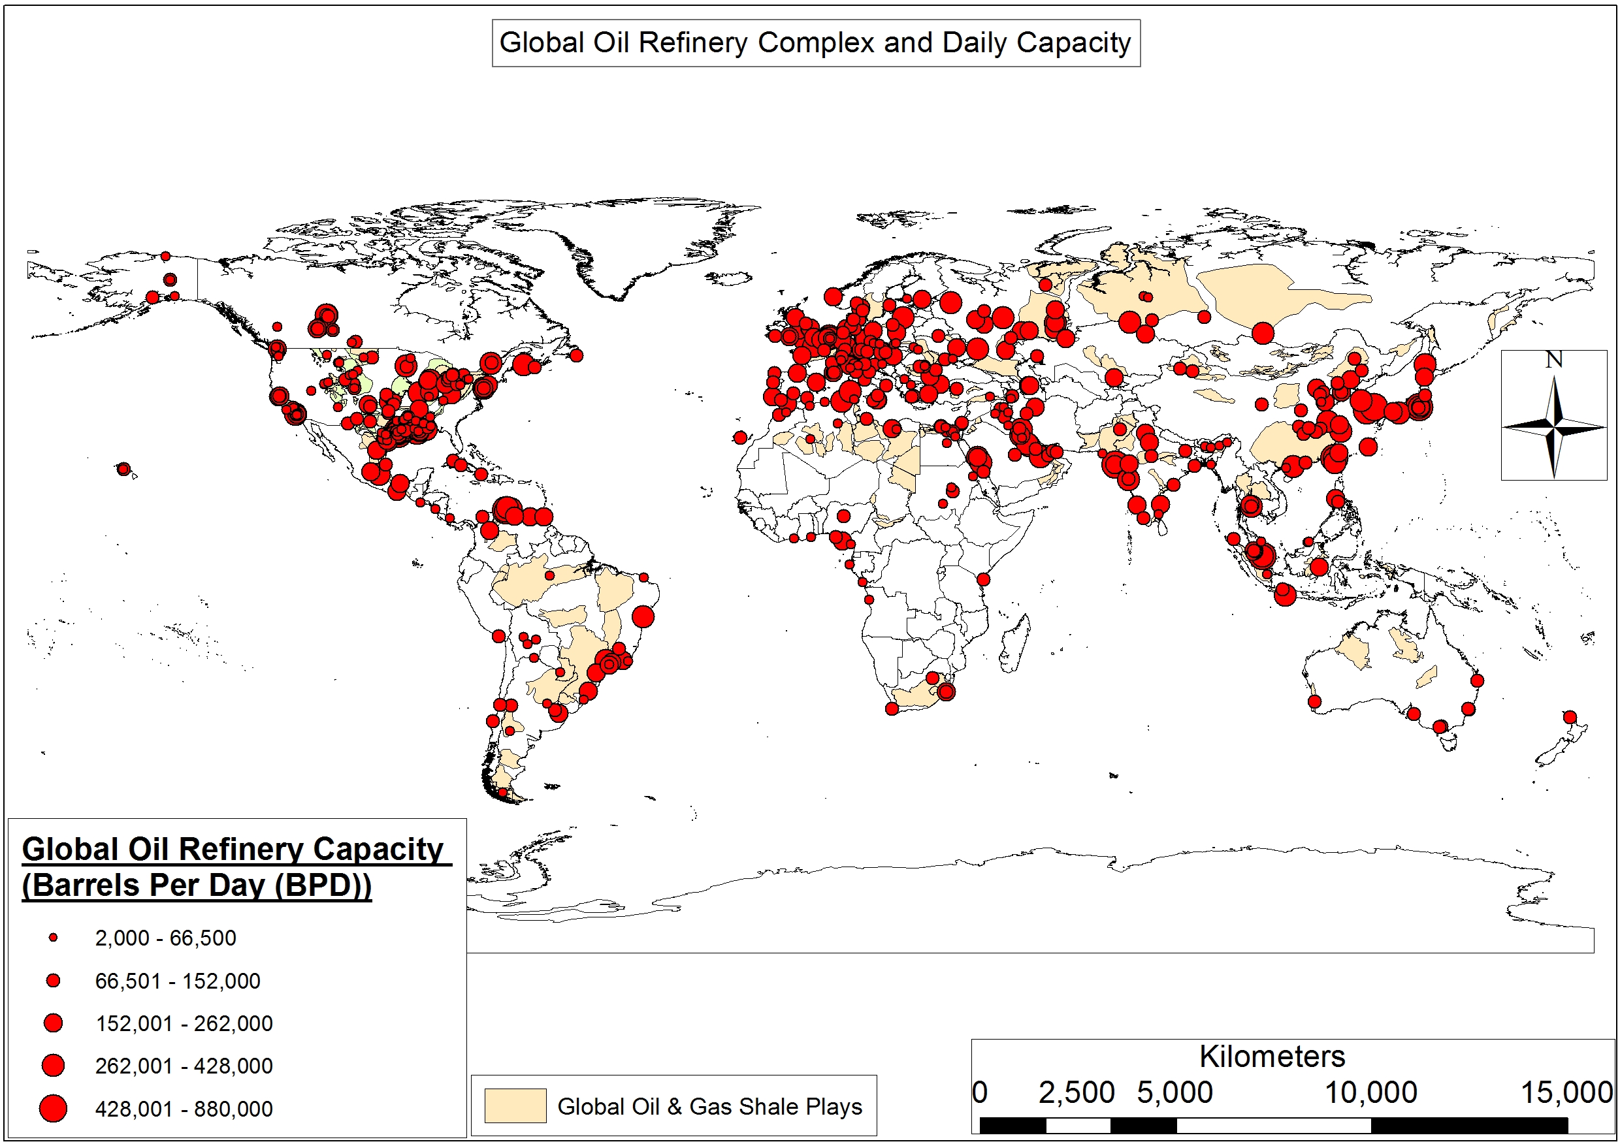
Introduction & Motivation
Company type
Oil Trading and Shipping
Capacity Database
Supply
Structured Event List Data
Price
Demand
Refinery News

Slide 5
02
METHODOLOGY
Choice of Techniques
System Work

Slide 6

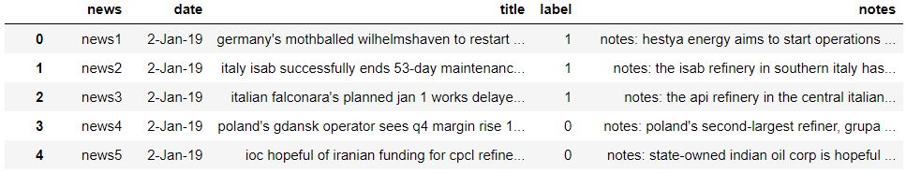
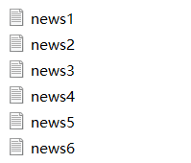
Methodology – System workflow
Data Representation
Document Retrieval
Input
Keywords
tf
Output
News details
A single refinery news txt file
A txt corpus and a csv file
Topic Modelling
Input
Titles
LDA
Output
Topic details
Document Classification
Information Extraction
Input
Titles
Notes
units affected
labels
Data preparation
Input
Content
Token
Output
Structured data
Output
Predict labels
Pre-defined function
TF-IDF
Naïve Bayes
SVM
Random Forest
Input
Content
Fine-tuned
pre-trained model
Output
Structured data

Slide 7
03
EXPERIMENTS & ANALYSIS
Data Representation
Document Retrieval
Topic Modelling
Document Classification
Information Extraction

Slide 8
Experiments & Analysis – News Representation
What we have and what we want
What we want
What we have
A txt corpus
A csv file
A single refinery news txt file
1321 files
1321 rows
Contains 1321 news
Notes:
What we have a single refinery txt file and what we want are a txt corpus where each single txt file represents a piece of news and a csv file where each rows represents a piece of news.

Slide 9
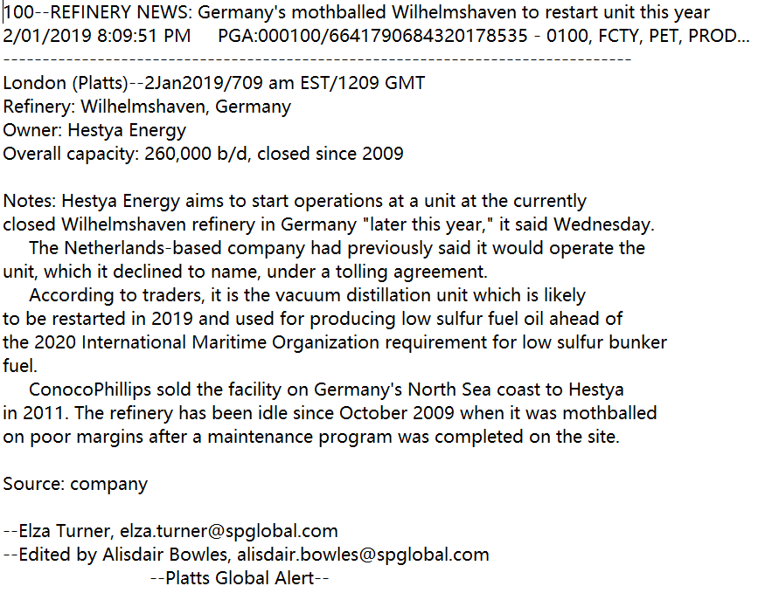
Experiments & Analysis – News Representation
From a single txt file to a corpus
1. start of a piece of news
Opened a new txt file / appended to exist file
Extracted titles after ‘:’
3. Retrieve date values
Involved
4. Need to be recognized
Involved
2. Do not need
Not included
Notes:
Then how can we do that? First we Find common features of all news and process accordingly. For example, 100 – refinery news colon Represents the start the news, if this feature requirement is satisfied when we are reading the txt file line by line, we open a new txt file and we append all other content we need to the txt.

Slide 10
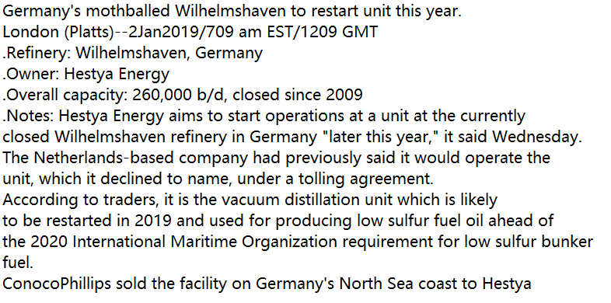
Experiments & Analysis – News Representation
From a single txt file to a csv file
News1.txt
News number
Title
Date
Label : decrease?
Manually done
Notes
Notes:
Now we have the corpus and extract the required information from each single txt file to a dataframe. One more thing we need to do is labelling.
If the news including the information of decrease production of the oil, we label it as 1, otherwise it is 0.

Slide 11
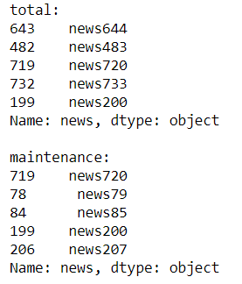
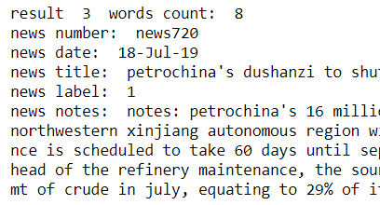
Experiments & Analysis – Document Retrieval
workflow
Dataset
File used – csv file
Text used – titles and notes
Result - Demo
Get the document details according to tf
top n news number
News details
(Pandas, nlargest)
Data Preparation
Tokenization (nltk)
Preserved English words (RE)
removed stop words (nltk)
stemmed the words (nltk)
Term frequency (Counter)

Slide 12
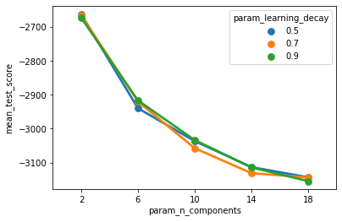
Experiments & Analysis – Topic Modelling
Preparation and Parameter Setting
Dataset
File used – csv file
Text used – titles only / notes only
Model Selection
titles only / notes only
LDA (genism / sklearn)
Parameter Setting
Topic number – 6
Learning delay – 0.9
Iteration – 10 (default)
perplexity – 80.32
Data Preparation
Lemmatization (spaCy)
Removed stop words
Customize stop words
Countries / organizations / date (NER, spaCy)
previous results
Stop words list (sklearn)
Notes:
Stop words: besides the stop words list in the sklearn we customize another stop words list contains two part: one is … another is from the previous results which do not have real meaning (‘unit’, ‘refinery’)
As for the model selection, we use titles only according to the perplexity number
and according to the pyLDAvis picture showed in the html file we select sklearn.
we selected 6 as topic number, which is based on the consulting result of expert with domain knowledge. And the perplexity is 80.32.

Slide 13
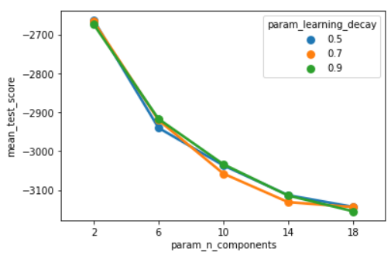

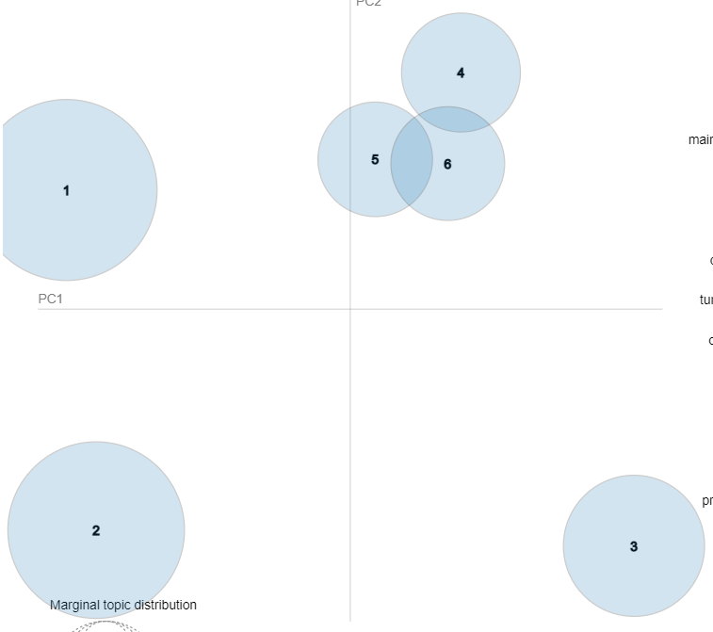
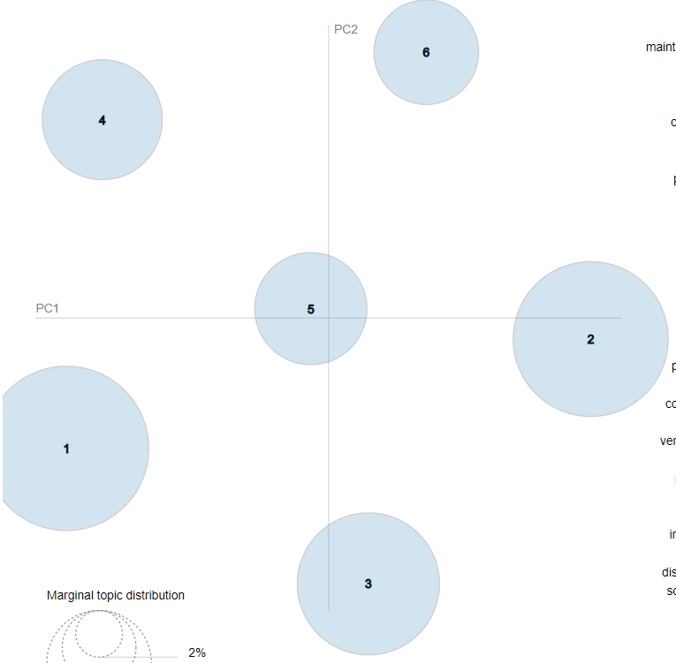

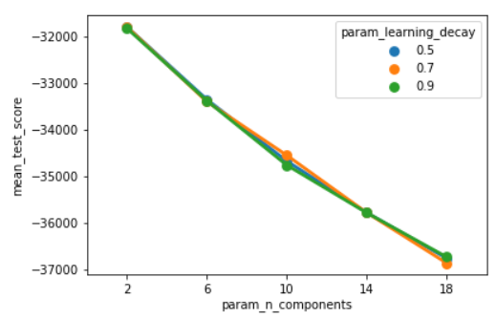
Experiments & Analysis – Topic Modelling
Preparation and Parameter Setting
Dataset
File used – csv file
Text used – titles only / notes only
Model Selection
LDA (genism / sklearn)
Different perplexity
Sklearn - no coherence score but calculate approximate log-likelihood Use pyLDAvis
Titles only
genism
sklearn
notes only
E[log p(theta | alpha) - log q(theta | gamma)]
E[log p(beta | eta) - log q (beta | lambda)]
Notes:
Estimate the variational bound.
Estimate the variational bound over "all documents" using only the documents passed in as X. Since log-likelihood of each word cannot be computed directly, we use this bound to estimate it.

Slide 14
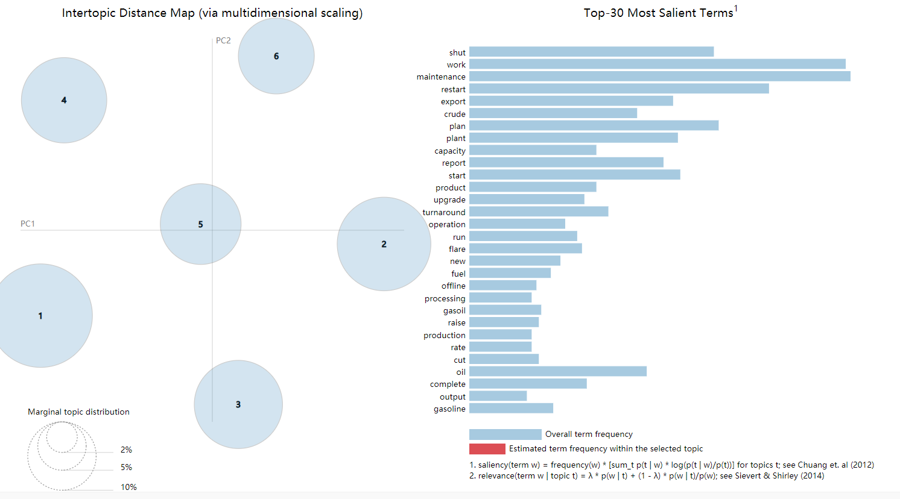
Experiments & Analysis – Topic Modelling
Results Analysis

Slide 15
Experiments & Analysis – Topic Modelling
Results Analysis

Slide 16
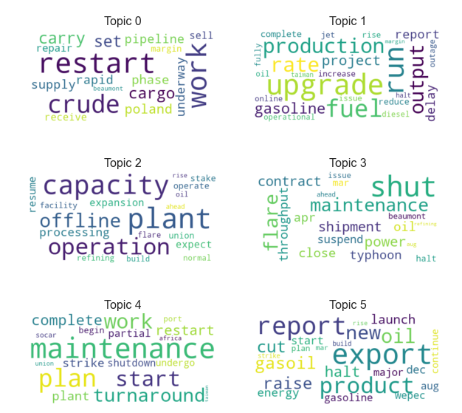
Experiments & Analysis – Topic Modelling
Results Analysis
Most Frequent 5 Words
restart, work, crude, carry, set
Main Content
The refinery plant restarts to work from halting
Target Label Ratio
49.5%

Slide 17
Experiments & Analysis – Topic Modelling
Results Analysis
Most Frequent 5 Words
upgrade, run, fuel, production, rate
Main Content
The upgrade and extension project of production rate in fuel refinery complete or delay
Target Label Ratio
28.4%

Slide 18
Experiments & Analysis – Topic Modelling
Results Analysis
Most Frequent 5 Words
plant, capacity, operation, offline, processing
Main Content
The refining operation capacity of refinery plant
Target Label Ratio
40.5%

Slide 19
Experiments & Analysis – Topic Modelling
Results Analysis
Most Frequent 5 Words
shut, flare, maintenance, power, shipment
Main Content
Oil refinery shut down because of issues such as maintenance or flare
Target Label Ratio
73.0%

Slide 20
Experiments & Analysis – Topic Modelling
Results Analysis
Most Frequent 5 Words
maintenance, plan, start, work, turnaround
Main Content
The maintenance of refinery plant starts or completes
Target Label Ratio
82.5%

Slide 21
Experiments & Analysis – Topic Modelling
Results Analysis
Most Frequent 5 Words
export, report, product, oil, new
Main Content
Export of energy production such as oil or gasoil
Target Label Ratio
23.6%

Slide 22
Experiments & Analysis – Topic Modelling
Results Analysis
Domain Topic | Main Content | Document Count | Target Label Ratio
Topic_0 | The refinery plant restarts to work from halting | 281 | 49.5%
Topic_1 | The upgrade and extension project of production rate in fuel refinery complete or delay | 204 | 28.4%
Topic_2 | The refining operation capacity of refinery plant | 195 | 40.5%
Topic_3 | Oil refinery shut down because of issues such as maintenance or flare | 148 | 73.0%
Topic_4 | The maintenance of refinery plant starts or completes | 315 | 82.5%
Topic_5 | Export of energy production such as oil or gasoil | 178 | 23.6%

Slide 23
Experiments & Analysis – Document Classification
STEP 1
STEP 3
Dataset:
Labelling: news related with unexpected events which affects the oil production (Maintenance, fire, strike etc.)
Dataset: new title, news content and “units affected”
Model preparation:
Word representation：Tf-idf
Test & Training data split: 33%
Cross validation：3-fold
Measurement score: F-beta 1.5
1
2
3
4
STEP 2
STEP 4
Models:
1. Naïve Bayes: fast processing time, less work on hyper parameter tunning
2. SVM: linear kernel is good for binary classification model. Hyper parameter tunning: C
3. Random Forest: ensemble learning method. Hyper parameter tunning: min_samples_split, and n_estimators
Data pre-processing:
Expanding contractions, lowercasing the text, removing non-importance features (e.g., extra newlines, special characters, and stop words) and lemmatization.
Notes:
C is the penalty parameter of the error term. It controls the trade off between smooth decision boundary and classifying the training points correctly.

Slide 24
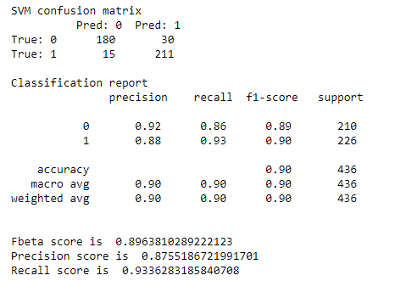
Experiments & Analysis – Document Classification (cont’d)
Model comparison
SVM model performance
Naïve Bayes has relatively low F-beta score, mainly due to low precision score.
Random Forest has similar performance as SVM, but it shows the sign of overfitting.
Hence SVM is the chosen mode.
15 positive news: misclassified as neutral
30 neutral news: misclassified as positive
Neutral news is more prone to misclassification error.
Models | Parameters | Precision score | Recall score | F-beta score (beta = 1.5)
Naive Bayes | None | 0.79 | 0.95 | 0.84
SVM | C= 0.4, Kernel = 'linear' | 0.88 | 0.93 | 0.9
Random Forest | min_samples_split = 5, n_estimators= 60 | 0.83 | 0.92 | 0.86

Slide 25
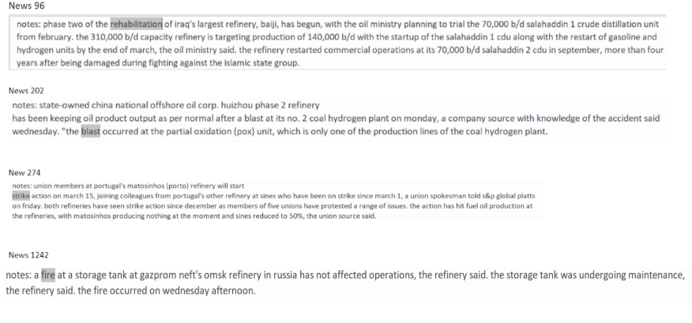
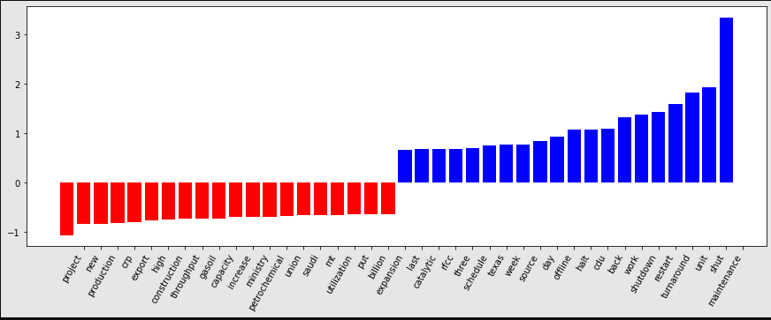
Experiments & Analysis – Document Classification (cont’d)
Top 20 influential words
News which have false negative error
1. Blue colored bars represent the positive news; red colored bards are for neutral news.
2. “maintenance” is the most prominent feature, followed by “shut”, “unit”, “turnaround”, “shutdown”, “work”, and “back”.
3. Not many words standing out in neutral class. Apart from word “project”, which has a slightly higher weight, the rest of words share the similar weight.
4. In order to classify news as neutral class, more neutral words need to appear together to out weight the positive words.
We can further summarize the news of false negative error into 3 categories, rare words, ambiguous words, and mislabeled text.

Slide 26
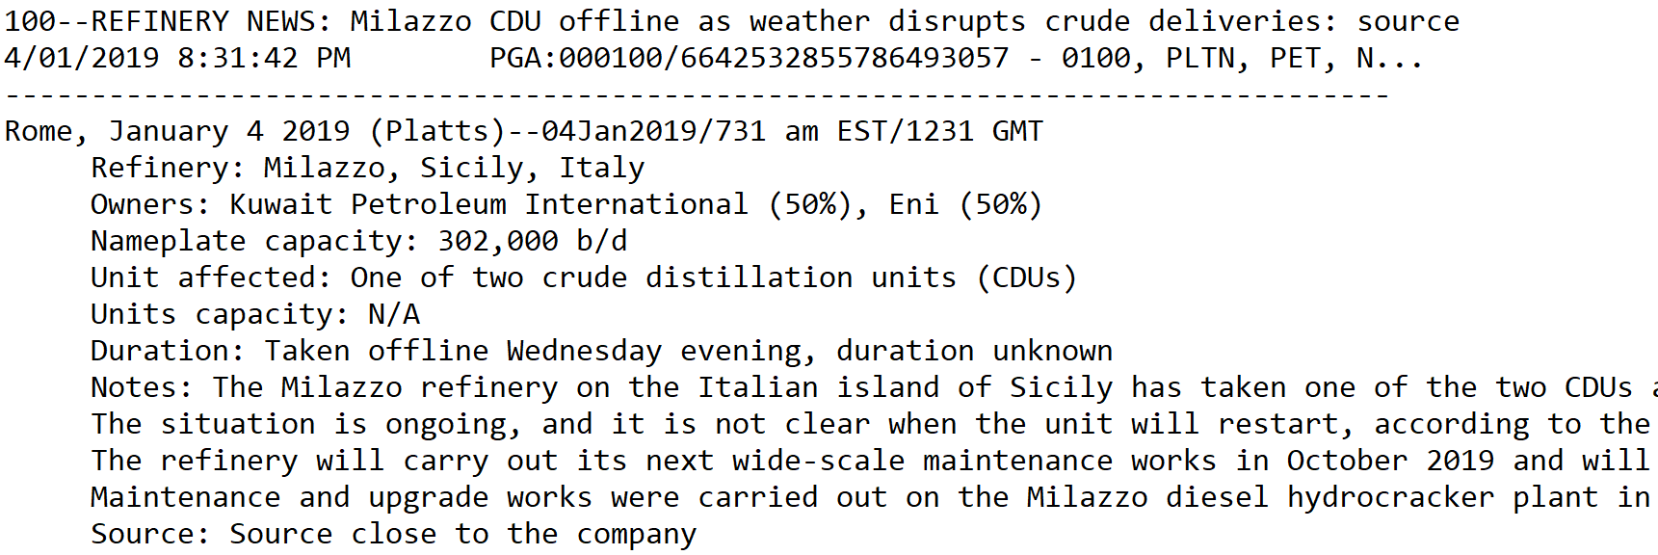
Experiments & Analysis – Information Extraction
Method
IE part 2: reason in the title
Part 1. String operation and slicing
Standard information like refinery name, capacity, unit, duration etc.
Part 2. Transfer Learning
Non-Standard information like reason of refinery plant shut down
IE part 1: obvious in the news

Slide 27
Experiments & Analysis – Information Extraction
Workflow
Lemmatize and prepare the training data
Load the pre-trained model “en_core_web_sm” which is a CNN model
Set 10 iterations to train the model
Test the result of fine tuned pre-trained model
Training data format:
[(‘a string’, {‘entities’: [(the start index, the end index, “entity name”)]}), (…)]
1
2
Part 2. Transfer Learning
Disable pipeline components don’t want to change
Import packages from spacy.util, path from pathlib and example from spacy.trianing
3
Shuffle the train_data to avoid generalization
4
Notes:
After load the pre-trained model, then we append our user defined entity name to the original NER list. The original NER support cardinal, date, event, fac, gpe, language, law, loc, money, norp, ordinal, org, percent, person, product, quantity, time, and work_of_art.
Then we disable pipeline components we don’t want to change, import packages random, minibatch and compounding from spacy.util, path from pathlib and Example from spacy.training.
We shuffle the train_data, this will ensure the model does not generalize based on the order of the examples. We set the iteration for 10 because the model need loop over the example for sufficient number of iterations, too few iterations may not be effective.

Slide 28
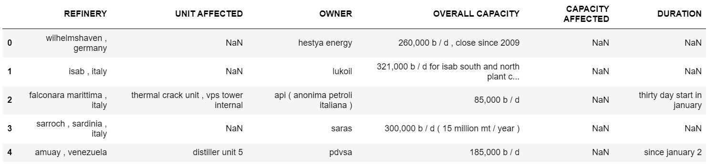
Experiments & Analysis – Information Extraction
Results
Part 1. String operation and slicing
Standard information like refinery name, capacity, unit, duration etc.

Slide 29
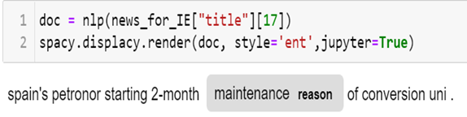
Experiments & Analysis – Information Extraction
Results
Part 2. Transfer Learning
Non-Standard information like reason of refinery plant shut down
IE part 2: Reason is user defined NER

Slide 30
04
Conclusion
Discussions and Gap Analysis
Future Work and Conclusion

Slide 31
Conclusion
Performed Task
Outcome
Gap Analysis
Future Work
Document retrieval
Key words work well
Phrase level not working
Topic Modelling
6 different topics
Not accurate no of topics
Perplexity / coherence score
Document classification
SVM
Recall 0.93/F-1.5 0.9
Failed to recognize rare words
Increase sample weight
human labelling error
Word embedding
Information Extraction
Successfully extract part1 and recognize part of part2 information
Changeable pre-defined items
Try larger pre-trained model like BERT
Expensive training data
Easier ways

Slide 32
Conclusion
Performed Task | Outcome | Gap Analysis | Future Work
Document retrieval | Key words work good. | Phrase level not working.
Topic Modelling | Good results. | Our pre-defined number of topic may not be accurate. We only use title to train LDA model. | Use perplexity or coherence score to find the optimal number of topic. Try to use contend build topic model.
Document classification | SVM : 0.93 recall and 0.9 F-1.5 | Failed to recognize rare words (e.g., “rehabilitation”), human labelling error . | Increase sample weight Word embedding
Information Extraction | Successfully extract part1 information, can recognize part of part2 information. | Pre-defined items are changeable Hard to prepare enough annotated training data | Find easier ways to get annotated training data Try larger pre-trained model like BERT

Slide 33
05
Reflection
go beyond the learning in the
classroom

Slide 34
Reflection
Information extraction
pre-trained model
user defined NER
spaCy package
Document Representation
- Word Embedding
Train word embedding by self
Download directly from pre-trained model
01
02
04
03
Other text classifier
FastText
Text-CNN
Topic Modelling
Use Sklearn to train LDA model

Slide 35
Application
User
Get detail information of target news.
Document Retrieval
Commercial Analyst
Document Classification
Trading and Shipping Analysis Department
Use the extracted structured data to adjust the prediction of global oil supply.
Find target news
Information Extraction

Slide 36
Application
Get detail information of target news.
User
Commercial Analyst
Trading and Shipping Analysis Department
Document Retrieval
Document Classification
Use the extracted structured data to adjust the prediction of global oil supply.
Find target news
Information Extraction

Slide 37
Contribution
DONG Fang
Document retrieval; Topic modelling; Search external resource; Progress Control; News Labelling
In this project there are 4 tasks engaged, including Document Retrieval, Document Classification, Topic Modeling, and Information Extraction. When completing these tasks, we not only went through the relevant topic learning material obtained from class and understood the knowledge more deeply, but also browsed some external resources to learn more methods and models in order to achieve our objective. As for me myself, I mainly focus on the analyzing part for Document Retrieval and Topic Modeling. Besides, I have engaged in searching external resources and learning spaCy to resolve the problems encountered in Information Extraction tasks. Also, I have arranged the progress and timeline for the whole project process. As a team, we have experienced a highly efficient and comfortable cooperation. With reasonable job allocation, we have all played our best as we are good at different aspects. And what I like in this project is that our achievement is meaningful for business world, and I believe the solution or models we came up with could really help the company understand the industry better and reduce the cost of getting information they need.

Slide 38
Contribution
LU Di
News labelling ; Data Processing; Classification
The text of our Project comes from energy news that is updated daily. Energy trading companies need to judge the fluctuation of energy prices based on this news to specify the correct trading strategy. This type of news can be divided into two categories. The first type is news that will reduce crude oil production, such as an explosion or fire in an oil refinery, and the other is news that will not affect crude oil production. I am responsible for label part of these news manually and do the pre-process in the dataset in pandas to extract useful information from raw text and add into analyzed data frame. Although I have not learned machine learning before, but luckily my teammate has learned machine learning. So, they build the classification model and I do the pre-possess to extract more specific data from raw dataset to the model to improve its accuracy. I learned a lot in this project, such as data prepossess in pandas and machine learning commonly used packages such as sklearn, familiar with nature package nltk. I think our text classification model does can help energy company to classify news automatically and create real value.

Slide 39
Contribution
TANG Yue
Data processing; News Labelling; Classification model; Search external resource
This project gives me an opportunity to practice what I learned in class and explore how to apply text analysis technology to resolve problems in real business world. The objective of our project is to extract important information (potential topic) from news, retrieve target news and use machine learning model to automatically distinguish influential news from non-influential news. I mainly participate in news classification part. Before building classification, initially we did simple data processing and used naïve bayes and SVM model to classify news, but the result is not good. So, we use more text processing technologies to process data. In this process, I studied the text processing technologies including their respective processing tools, functions, and application. For example, in classification model we use spaCy library to complete tokenization, removing stop words, stemming and lemmatization etc. And after elaborated text processing, our classification models perform good, which lets me know the importance and necessity of data processing. Besides, this project also guides me to use mathematic method to process and analyze data no matter the data is text or numeric. For example, we use TF-IDF to prepare data before feeding in models. Moreover, in this project, I studied how to use spaCy, NLTK and Scikit-learn to process data and build corresponding models to achieve our analysis goals.

Slide 40
Contribution
YIN Xiaolan
Data pre-processing; News Labelling; Document retrieval; Topic modelling
We need the knowledge within and go beyond the learning in the classroom to implement this project. During the process we practiced what we have learned in lecture and lab and tried some new packages of doing text analysis. When we are discussing about the project, I already had the idea of doing document retrieval. So, I did part of the data representation, change the single txt file to a txt corpus, then I did the design and experiment part of the document retrieval and help Jiale further implement the model building part of topic modelling, and then added the evaluation of the models, topic distribution, label ratio, top n keywords of each topic, also the word cloud. In addition, I designed the methodology, data representation, document retrieval, conclusion, and reflection part of the ppt. From the teamwork I see that the communication is very important. We can share our ideas and align what we want to do. I like the project since we can practice different text analysis method and solve real business problems.

Slide 41
Contribution
YOU Pingping
Classification, News labelling , Data Processing;
This is my first text analytics project. It is a fun journey to work with my team to churn out some useful insights from the text dataset. During the project, I was responsible for the text classification task. With the machine learning techniques, I learned from another course and the concepts and text unique dataset structure learnt in this course, I was lucky to build my very first text classifier with quite high measurement score. Surprisingly, I enjoyed the process of data preprocessing. It is fascinating to see the text transformed into numbers and fed into the machine models. For my least favorite part in this project, I think it should go to the data labelling task. As I do not have industry knowledge to decide which texts should be labeled as positive, I had to check with dataset owner, Jiale, several times when I started my labelling task. Eventually I managed to label 260 new texts.

Slide 42
Contribution
ZHANG Jiale
Data pre-processing; News labelling and guidance; Topic modelling; Information extraction
This project is one of my internship projects. When we start our project, the first thing I do is share with my team members the domain knowledge since I am the only person understand what the company is looking from the refinery news and why they are looking for that information. Then based on the pre-processing work of Xiaolan, I updated some codes in order to ensure the corpus can be successfully tokenize and generate the CSV file for later use. In terms of the four tasks, I mainly contribute to 2 of them, one is topic modelling, another is information extraction. I build a base LDA model then Xiaolan further refined the model and Dong Fang analyzed the final results. I also tried use regular expression to do information extraction, but find it is not a good solution. With the help of Dong Fang, she shared with me many external sources to do information extraction, I learned how to fine tune a pre-defined model to train user defined NER using spaCy. For some information, I use tokenization and self-define functions to extract the information. And for the NER ‘reason’, I manually annotated training data then trained the model to automated detect ‘reason’. Although I did not engage too much on the model part of text classification, I contribute more on the labelling process. I make the guidance to my team members how to label the news, and I finished labeling all the news then compare their labelling results with mine to ensure our labels are correct. In terms of the learning experience, the best things I learned from this project are the good package spaCy and use a pre-trained model to train self-defined NER. Moreover, our team members are awesome, we have a good cooperation with each other. I like this project because it let me feel we are generating value for a real business and what we have learned are powerful.

Slide 43
THANKS
Q&A

